Slide 1
Introduction To JavaScript

Slide 2

JAVASCRIPT the brain
JavaScript

Slide 3
Scripting Language
Scripting refers to a series of commands that are interpreted and executed sequentially and immediately on occurrence of an event.
This event is an action generated by a user while interacting with a Web page.
Examples of events include button clicks, selecting a product from a menu, and so on.
A scripting language refers to a set of instructions that provides some functionality when the user interacts with a Web page.
Scripting languages are often embedded in the HTML pages to change the behavior of the Web pages according to the user’s
Scripting Language
Client-side Scripting
Server-side Scripting

Slide 4


What is JavaScript ?
JavaScript is a scripting language that allows building dynamic Web pages by ensuring maximum user interactivity.
JavaScript language is an object-based language, which means that it provides objects for specifying functionalities.
In real life, an object is a visible entity such as a car or a table having some characteristics and capable of performing certain actions. Similarly, in a scripting language, an object has a unique identity, state, and behavior.
The identity of the object distinguishes it from other objects of the same type.
The state of the object refers to its characteristics, whereas the behavior of the object consists of its possible actions.
The object stores its identity and state in fields (also called variables) and exposes its behavior through functions (actions)
HTML CSS JAVASCRIPT

Slide 5
Client side JavaScript
A Client-side JavaScript (CSJS) is executed by the browser on the user’s workstation.
A client-side script might contain instructions for the browser to handle user interactivity.
These instructions might be to change the look or content of the Web page based on the user inputs.
Examples include displaying a welcome page with the user name, displaying date and time, validating that the required user details are filled, and so on.
A JavaScript is either embedded in an HTML page or is separately defined in a file, which is saved with .js extension.
In client-side scripting, when an HTML is requested, the Web server sends all the required files to the user’s computer.
The Web browser executes the script and displays the HTML page to the user along with any tangible output of the script.

Slide 6
Server side JavaScript
A Server-side JavaScript (SSJS) is executed by the Web server when an HTML page is requested by a user and the output is displayed by the browser.
A server-side JavaScript can interact with the database, fetch the required information specific to the user, and display it to the user.
Server-side scripting fulfills the goal of providing dynamic content in Web pages.
Unlike client-side JavaScript, HTML pages using server-side JavaScript are compiled into bytecode files on the server.
A JavaScript is either embedded in an HTML page or is separately defined in a file, which is saved with .js extension.
Compilation is a process of converting the code into machine-independent code.
This machine-independent code is known as the bytecode, which is an executable file that the Web server runs to generate the desired output.

Slide 7
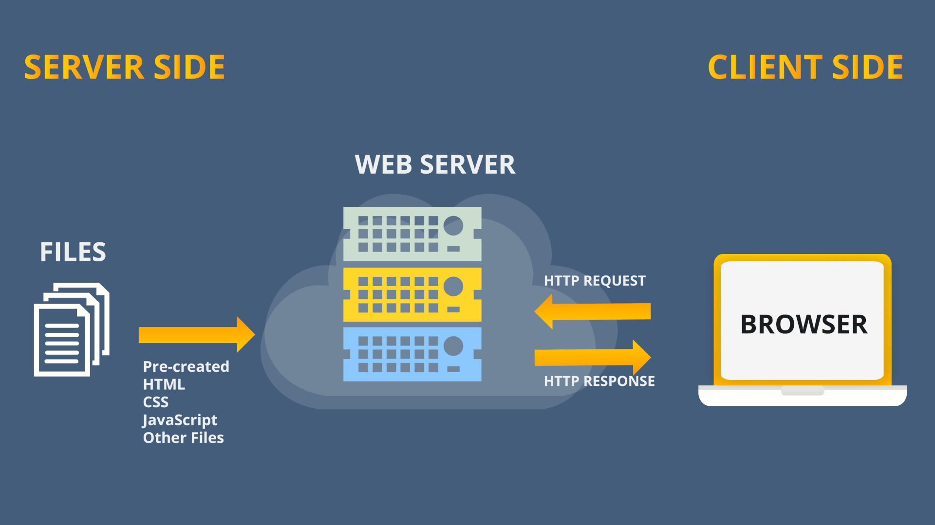
Server side VS Client side scripting

Slide 8
<script> Tag
The <script> tag defines a script for an HTML page to make them interactive.
The browser that supports scripts interprets and executes the script specified under the <script> tag when the page loads in the browser.
You can directly insert a JavaScript code under the <script> tag.
You can define multiple <script> tags either in the <head> or in the <body> elements of an HTML page.
In HTML5, the type attribute specifying the scripting language is no longer required as it is optional

Slide 9


Ways to import JavaScript
There are two main purposes of the <script> tag,
which are as follows:
Importing JavaScript
Import a JavaScript file using the <script> tag
Embed the code in the HTML using the <script> tag.

Slide 10
Methods
JavaScript allows you to display information using the methods of the document object.
The document object is a predefined object in JavaScript, which represents the HTML page and allows managing the page dynamically.
Each object in JavaScript consists of methods, that fulfill a specific task.
There are two methods of the document object, that display any type of data in the browser:
write(): Displays any type of data.
writeln(): Displays any type of data and appends a new line character.
The syntax demonstrates the use of document.write() method, which allows you to display information in the displayed HTML page. Syntax: document.write(“<data>” + variables); where,
data: Specifies strings enclosed in double quotes.
variables: Specify variable names whose value should be displayed on the HTML page.

Slide 11
Escape Sequence Characters
An escape sequence character is a special character that is preceded by a backslash (\).
Escape sequence characters are used to display special non-printing characters such as a tab space, a single space, or a backspace.
In JavaScript, the escape sequence characters must be enclosed in double quotes.
Some of the following escape sequence characters are:
Escape Sequence | Description
\n | New line
\t | Horizontal tab

Slide 12
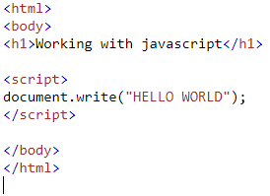
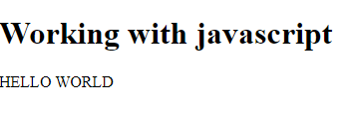
How to print text in JavaScript

Slide 13
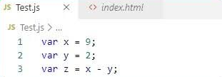
What are Variables in JavaScript?
A variable refers to a symbolic name that holds a value, which keeps changing.
For example, age of a student and salary of an employee can be treated as variables.
In JavaScript, a variable is a unique location in computer’s memory that stores a value and has a unique name.
The name of the variable is used to access and read the value stored in it.
A variable can store different types of data such as a character, a number, or a string.

Slide 14
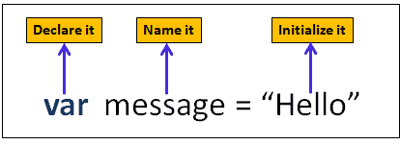
Declaring Variables
Declaring a variable refers to creating a variable by specifying the variable name.
For example, one can create a variable named to store the name of a student.
In JavaScript, the var keyword is used to create a variable by allocating memory to it.
a keyword is a reserved word that holds a special meaning.
the variable can be initialized at the time of creating the variable or later. initialization refers to the task of assigning a value to a variable.
once the variable is initialized, you can change the value of a variable as required.
variables allow keeping track of data during the execution of the script.
while referring to a variable, you are referring to the value of that variable

Slide 15
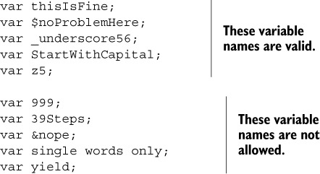
Variable Naming Rules
JavaScript is a case-sensitive language.
The variables X and x are treated as two different variables.
JavaScript consists of certain rules for naming a variable as follows:
cannot begin with a number and cannot contain any punctuation marks.
cannot contain any kind of special characters such as +, *, %, and so on.
must begin with a letter or underscore character.
can consist of digits, underscore, and alphabets.
cannot be a JavaScript keyword
cannot contain spaces.

Slide 16
Data Types in JavaScript
To identify the type of data that can be stored in a variable, JavaScript provides different data types.
Data types in JavaScript are classified into two broad categories namely, primitive and composite data types.
Primitive data types contain only a single value, whereas the composite data types contain a group of values
A primitive data type contains a single literal value such as a number or a string.
A literal is a static value that you can assign to variables

Slide 17
Primitive Data Type
Primitive Data Type | Description
Boolean | Contains only two values namely, true or false
Null | Contains only one value namely, null. A variable of this value specifies that the variable has no value. This null value is a keyword and it is not the same as the value, zero
Number (Integer, float) | Contains positive and negative numbers and numbers with decimal point. Some of the valid examples include 6, 7.5, -8, 7.5e-3, and so on
String | Contains alphanumeric characters in single or double quotation marks. Single quotes are used to represent a string, which itself consists of quotation marks. A set of quotes without any characters within it is known as the null string

Slide 18
Composite Data Types
A composite data type stores a collection of multiple related values, unlike primitive data types.
In JavaScript, all composite data types are treated as objects.
A composite data type can be either predefined or user-defined in JavaScript.
Following table lists the composite data types:
Composite Data Type | Description
Object | Refers to a collection of properties and functions. Properties specify the characteristics and functions determine the behavior of a JavaScript object
Functions | Refers to a collection of statements, which are instructions to achieve a specific task
Arrays | Refers to a collection of values stored in adjacent memory locations

Slide 19
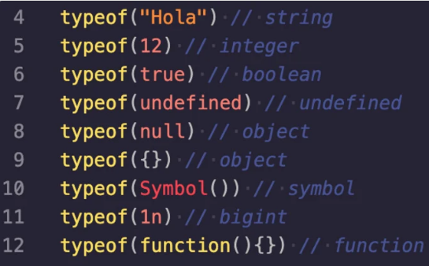
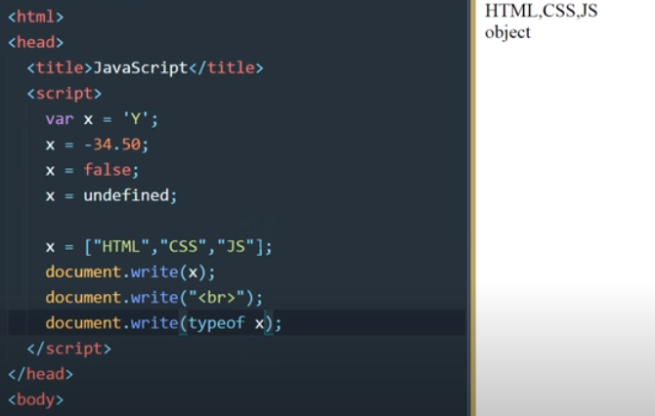
Data Types
It follows LOC(line of code)

Slide 20
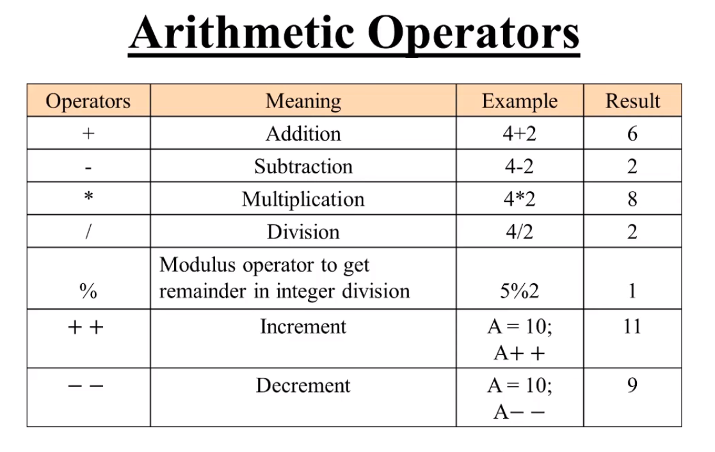
Arithmetic Operators
Are binary operators.
Perform basic arithmetic operations on two operands.
Operator appears in between the two operands, which allow you to perform computations on numeric and string values

Slide 21
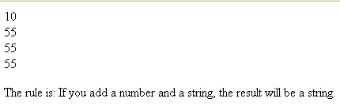
Simple code to print data with + operator
var x;
x=5+5;
document.write(x);
document.write("<br />");
x="5"+"5";
document.write(x);
document.write("<br />");
x=5+"5";
document.write(x);
document.write("<br />");
x="5"+5;
document.write(x);
document.write("<br />");

Slide 22
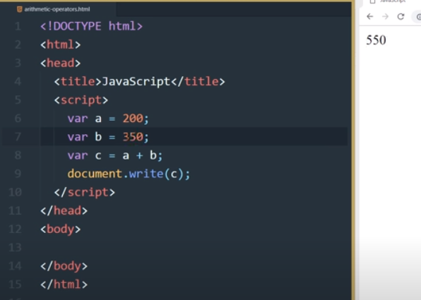
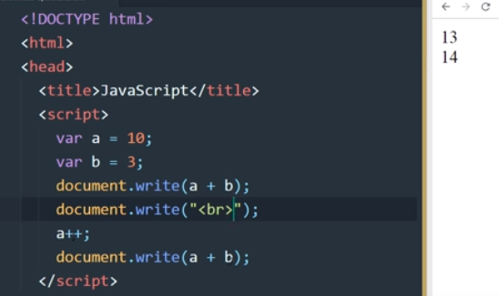
Working on Arithmetic Operators

Slide 23
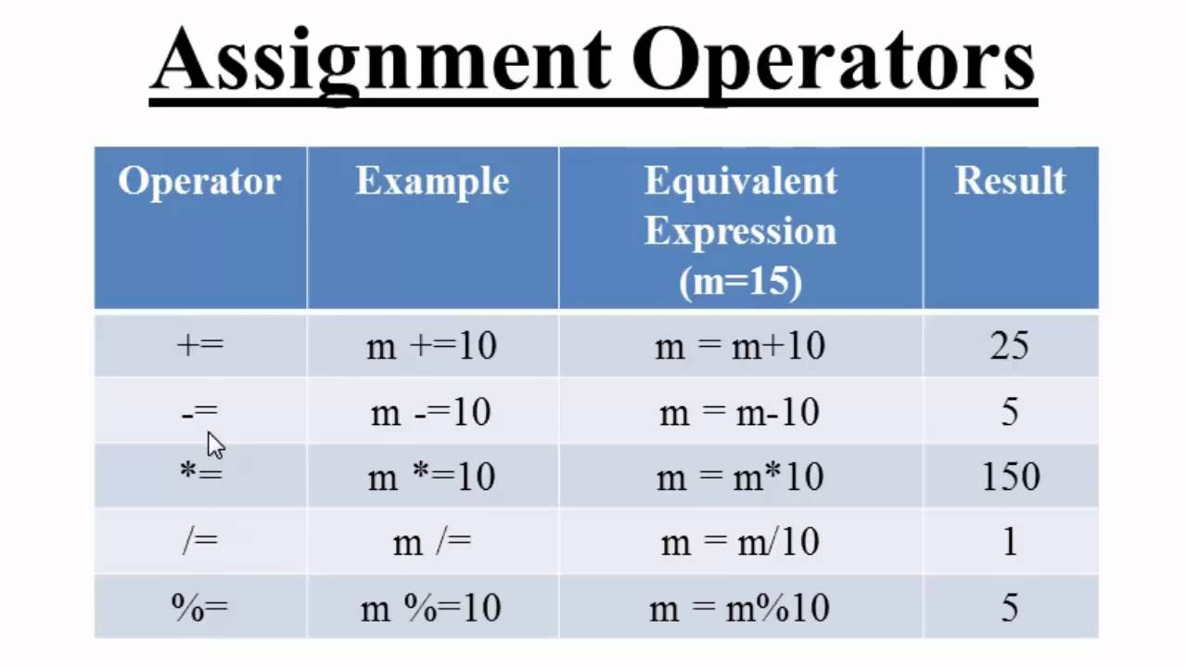
Assignment Operators
Assignment operators assign the value of the right side operand to the operand on the left side by using the equal to operator (=).
Simple assignment operator - Is the ‘=’ operator which is used to assign a value or result of an expression to a variable.
Compound assignment operator - Is formed by combining the simple assignment operator with the arithmetic operators.

Slide 24
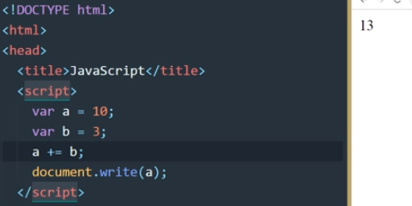
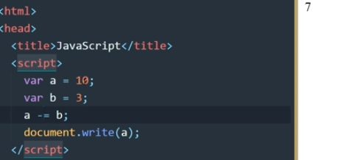
Working on Assignment Operators

Slide 25
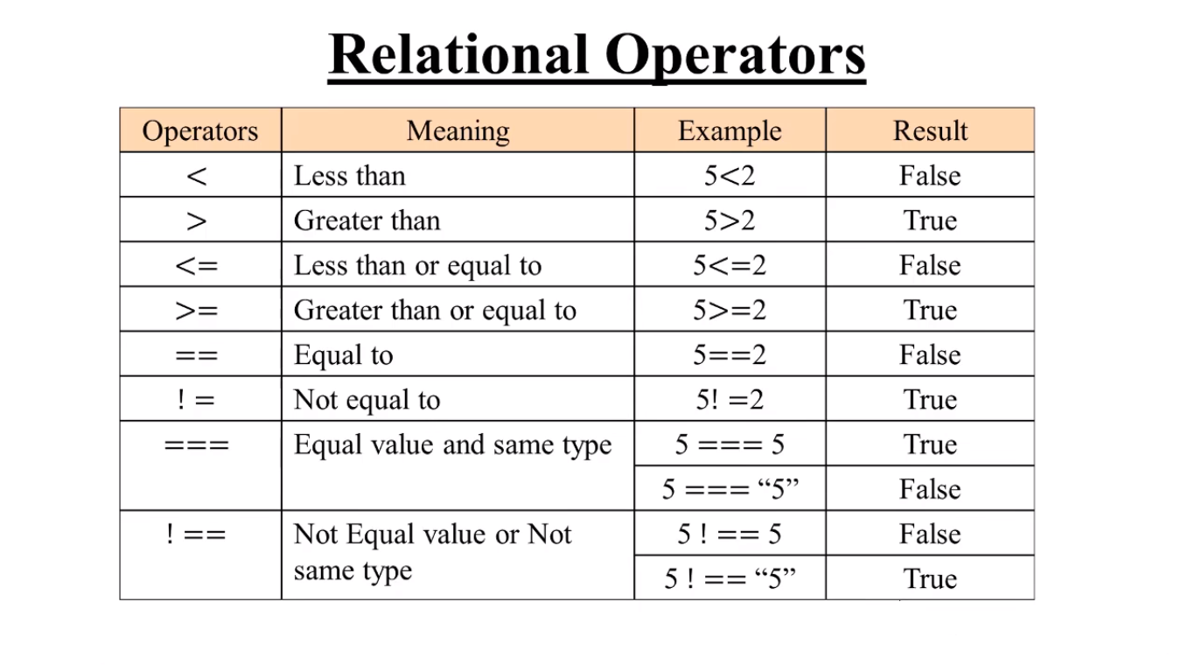
Relational Operators
Are binary operators that make a comparison between two operands.
After making a comparison, they return a Boolean value namely, true or false.
Expression consisting of a relational operator is called as the relational expression or conditional expression.

Slide 26
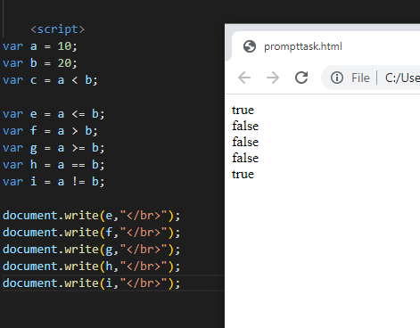
Working on Relational Operators

Slide 27
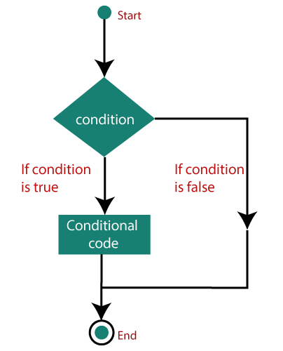
Decision-making Statements
Statements are referred to as a logical collection of variables, operators, and keywords that perform a specific action to fulfill a required task.
Statements help you build a logical flow of the script. In JavaScript, a statement ends with a semicolon.
JavaScript is written with multiple statements, wherein the related statements are grouped together are referred to as block of code and are enclosed in curly braces.
Decision-making statements allow implementing logical decisions for executing different blocks to obtain the desired output. They execute a block of statements depending upon a Boolean condition that returns either true or false

Slide 28
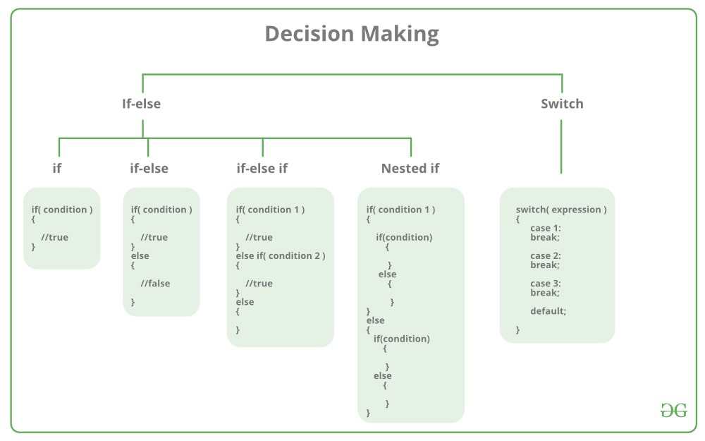
Different Types of Decision-making Statements

Slide 29
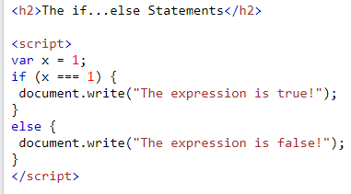
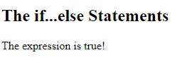
If-else statement
An if else statement in programming is a conditional statement that runs a different set of statements depending on whether an expression is true or false.
CODE
OUTPUT

Slide 30
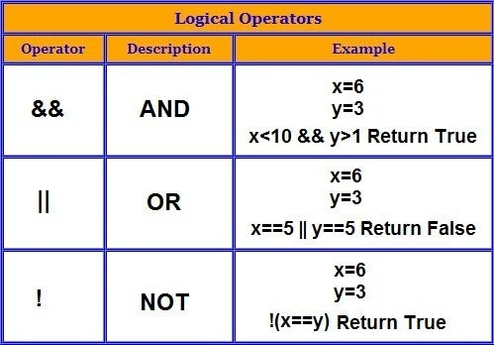
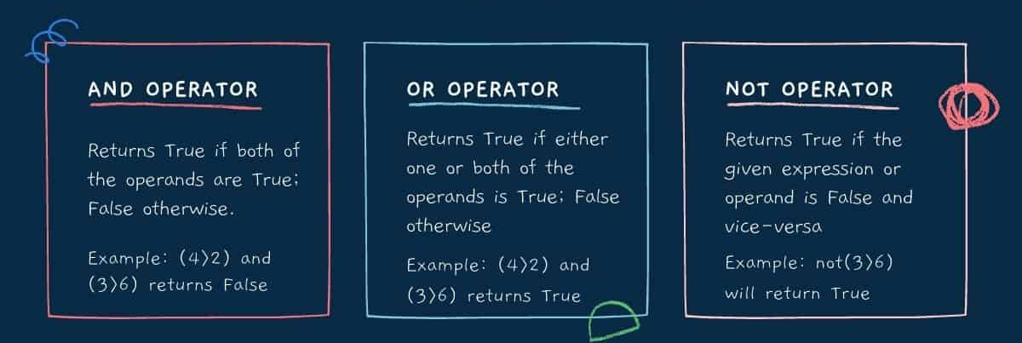
Logical Operators
Are binary operators that perform logical operations on two operands.
They belong to the category of relational operators, as they return a Boolean value.

Slide 31
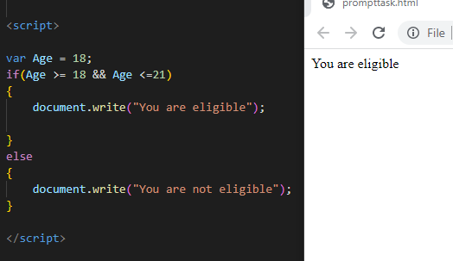
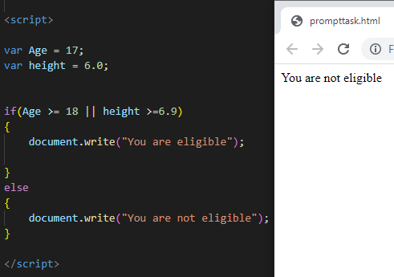
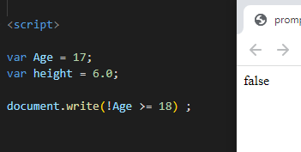
Working on Logical Operators
NOT
AND
OR

Slide 32
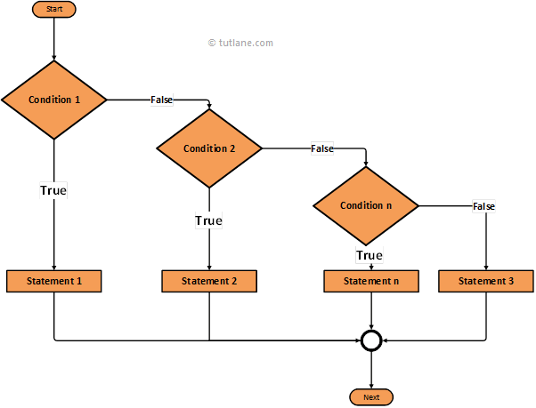
If else-if statement
The if/else-if statement Allows you to check multiple conditions and specify a different block to be executed for each condition.
Flow of these statements begins with the if statement followed by multiple else if statements and finally by an optional else block.

Slide 33
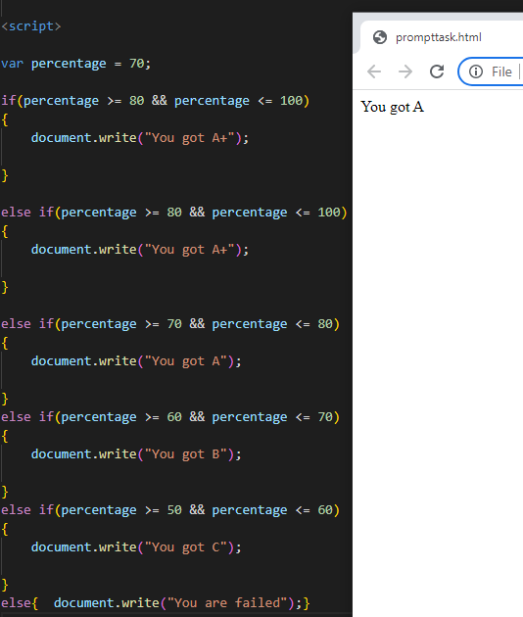
Else-if statement
Output

Slide 34
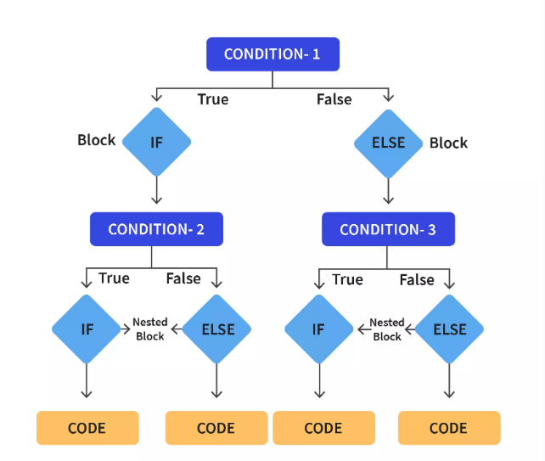
Nested if Statement
Comprises multiple if statements within an if statement.
Flow of the nested-if statements starts with the if statement, which is referred to as the outer if statement.
Outer if statement consists of multiple if statements, which are referred to as the inner if statements.
Inner if statements are executed only if the condition in the outer if statement is true.
Each of the inner if statements is executed but, only if the condition in its previous inner if statement is true

Slide 35
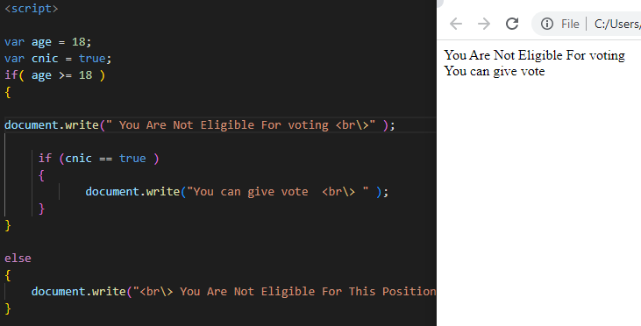
Write a code for voting eligibility
Nested if
Statement

Slide 36
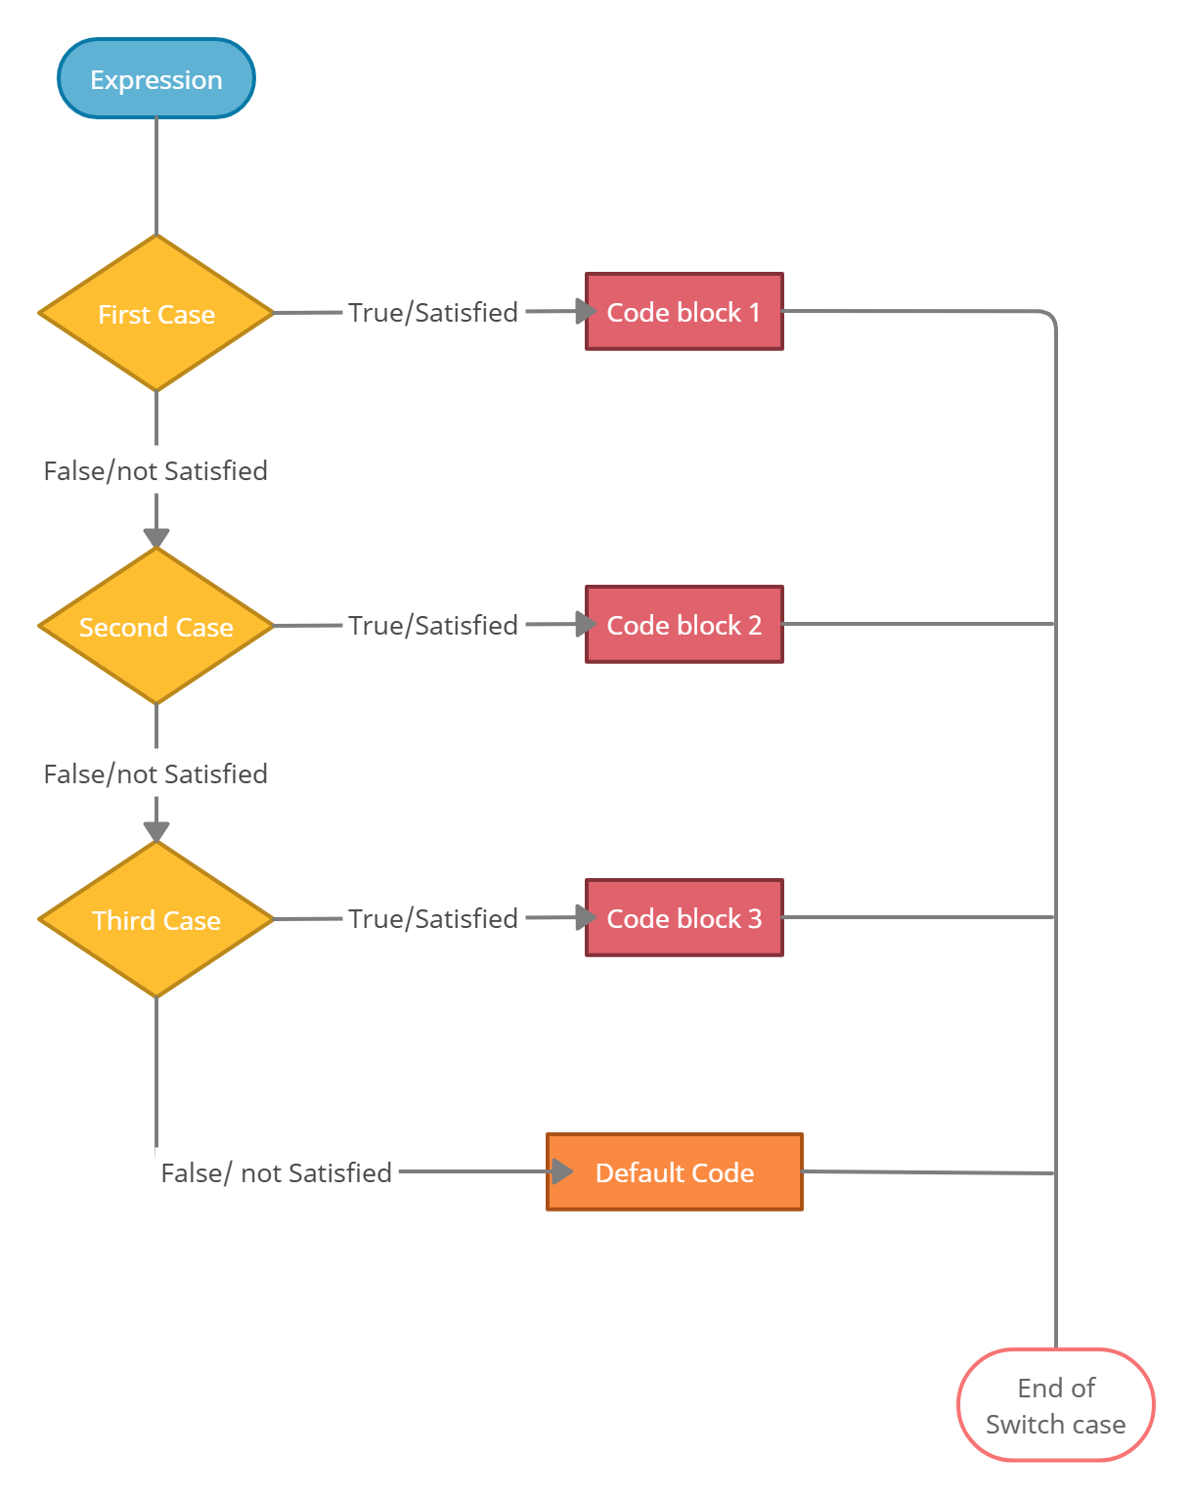
switch-case Statement
A program becomes quite difficult to understand when there are multiple if statements.
To simplify coding and to avoid using multiple if statements, switch-case statement can be used.
switch-case statement allows comparing a variable or expression with multiple values

Slide 37
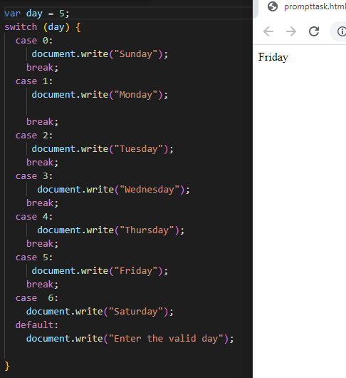
Working on switch-case Statement

Slide 38
JavaScript Built-In Functions

Slide 39
Built-in Functions
A function is a piece of code that performs some operations on variables to fulfill a specific task.
It takes one or more input values, processes them, and returns an output value.
Following table lists the built-in JavaScript functions:

Slide 40
Function | Description | Example
alert() | Displays a dialog box with some information and OK button | alert(“Please fill all the fields of the form”); Displays a message box with the instruction
confirm() | Displays a dialog box with OK and Cancel buttons. It verifies an action, which a user wants to perform | confirm(“Are you sure you want to close the page?”); Displays a message box with the question
parseInt() | Converts a string value into a numeric value | parseInt(“25 years”);
parseFloat() | Converts a string into a number with decimal point | parseFloat(“10.33”); Returns 10.33
prompt() | Displays a dialog box that accepts an input value through a text box. It also accepts the default value for the text box | prompt(“Enter your name”, “Name”); Displays the message in the dialog box and Name in the text box.

Slide 41
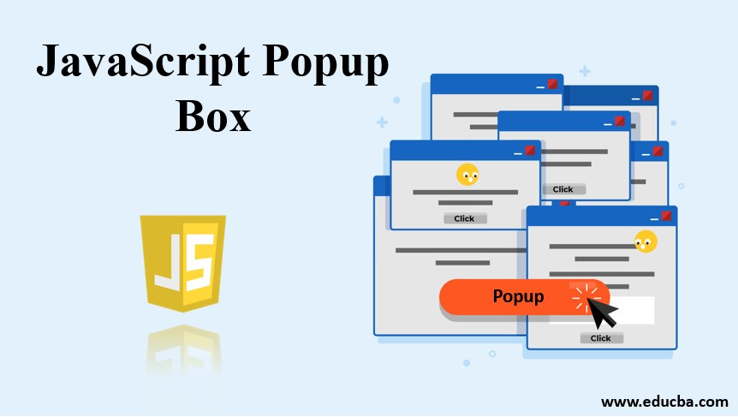
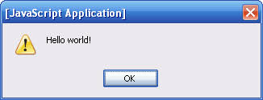
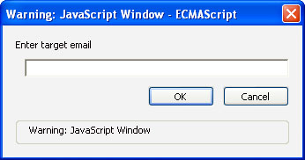
POPUP BOXES

Slide 42
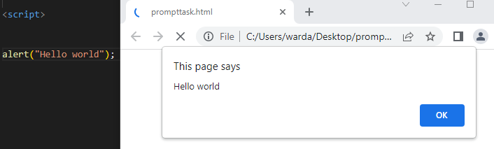
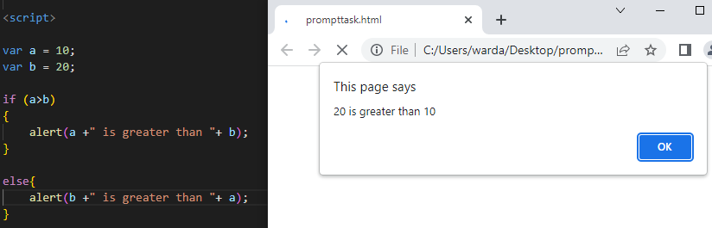
Alert box
Alert box With if statement

Slide 43
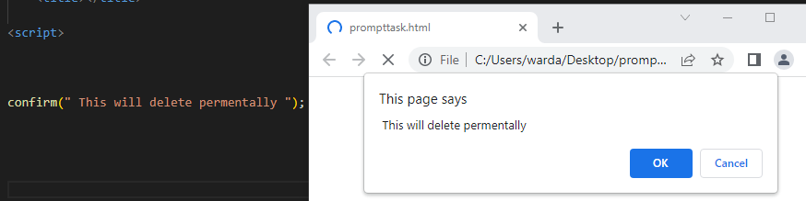
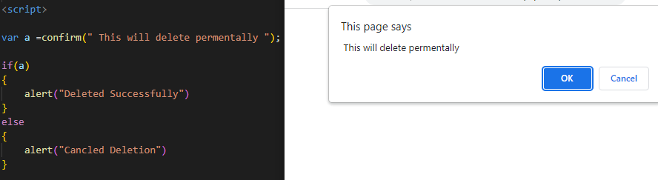
Confirm box
Confirm box With if statement

Slide 44
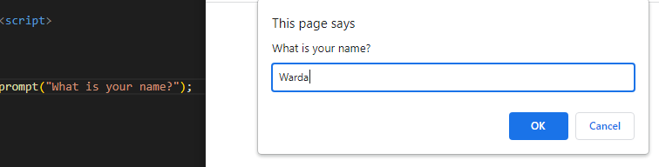
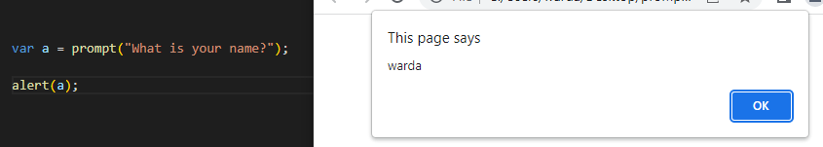
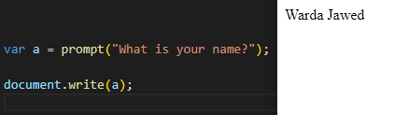
Prompt box
2 ways to print name

Slide 45
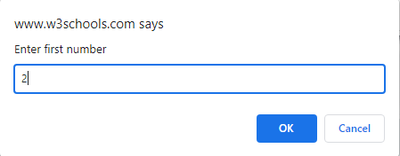
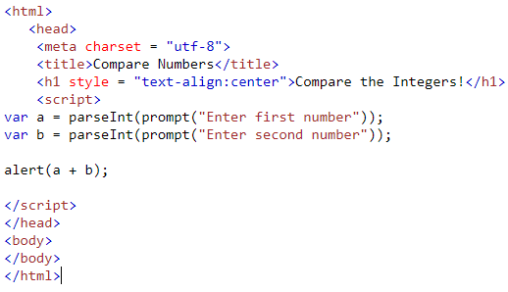

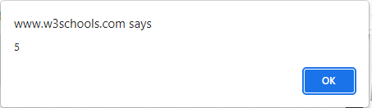
Task to print sum of 2 integer from user input

Slide 46
JavaScript Functions

Slide 47
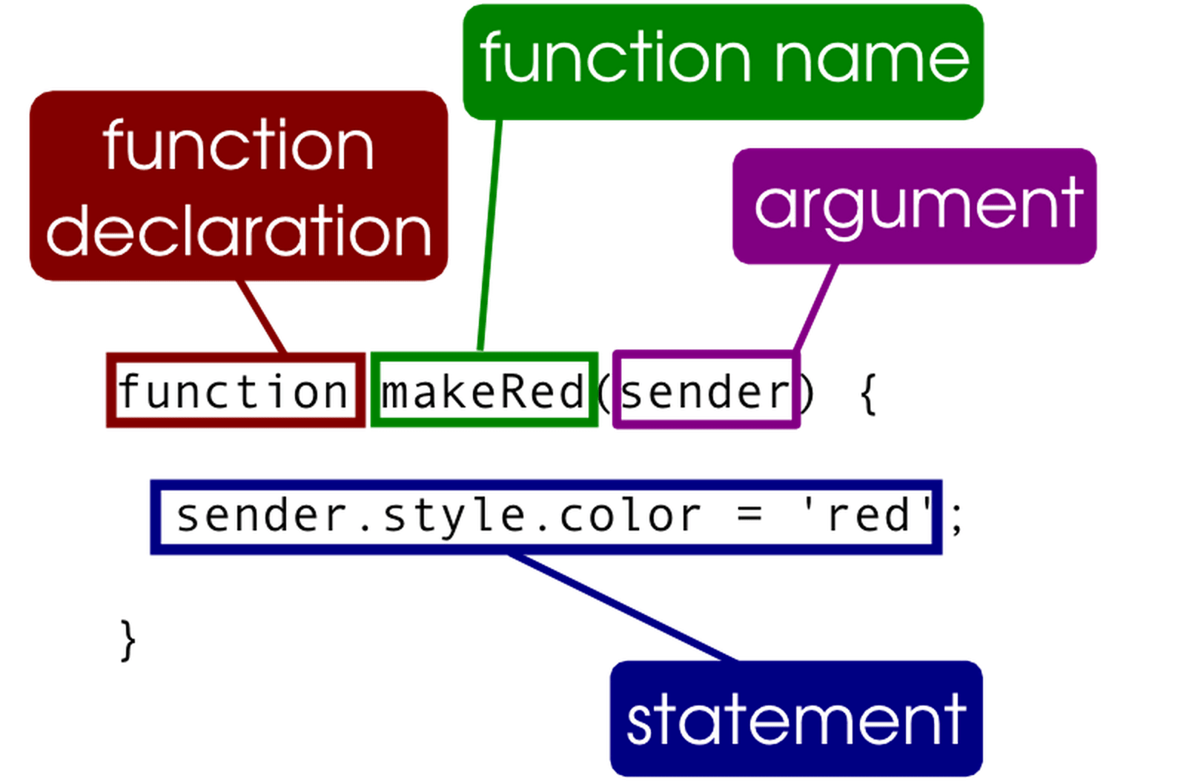
Functions
A function is an independent reusable block of code that performs certain operations.
It is always created under script element.
A function is declared using function keyword.
The keyword is followed by the name of the function and parameters enclosed within the parenthesis.
A function needs to be invoked.
To invoke a function, specify the function name followed by parenthesis outside the function block.

Slide 48
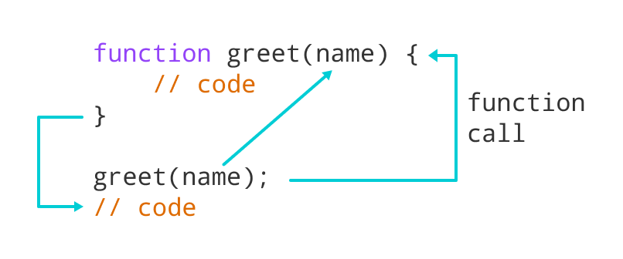
Defining function
Each function in a script is given a unique name
The layout of a function always follows the same format, including these three things:
The word "function"
The function's name, followed by parentheses (which may or may not be empty)
Curly braces containing the function's code

Slide 49
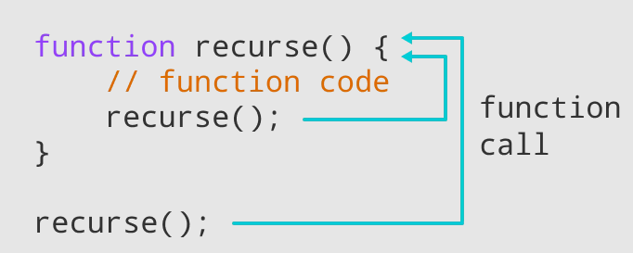
Calling function
Functions do not run automatically.
When the page loads, each function waits quietly until it is told to run.
Calling the function actually performs the specified actions.

Slide 50
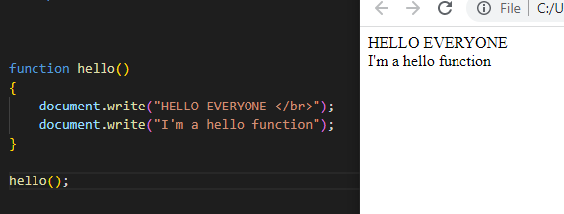
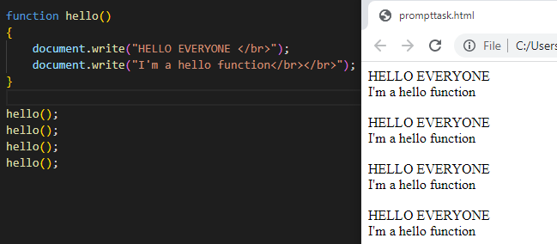
Making a simple function
Declaring
Calling
You can also call a function many times as you want

Slide 51

JavaScript Function with Parameters
The JavaScript Function Parameters are the names that are defined in the function definition and real values passed to the function in the function definition are known as arguments.
Parameter Rules:
There is no need to specify the data type for parameters in JavaScript function definitions.
It does not perform type-checking based on the passed-in JavaScript functions.
It does not check the number of received arguments

Slide 52



JavaScript Function with Parameters
Reusing function
Sum function

Slide 53

Event Handling
An event occurs when a user interacts with the Web page.
Some of the commonly generated events are mouse clicks, key strokes, and so on.
The process of handling these events is known as event handling.
Following figure displays the event:

Slide 54
Event Handling
Event handling is a process of specifying actions to be performed when an event occurs. This is done by using an event handler.
An event handler is a scripting code or a function that defines the actions to be performed when the event is triggered.
When an event occurs, an event handler function that is associated with the specific event is invoked.
The information about this generated event is updated on the event object.
The event object is a built-in object, which can be accessed through the window object.
It specifies the event state, including information such as the location of mouse cursor, element on which an event occurred, and state of the keys in a keyboard

Slide 55
Life Cycle of an Event
An event’s life starts when the user performs an action to interact with the Web page.
It finally ends when the event handler provides a response to the user’s action.
Steps involved in the life cycle of an event are as follows:
1. The user performs an action to raise an event.
2. The event object is updated to determine the event state.
3. The event is fired.
4. The event bubbling occurs as the event bubbles through the elements of the hierarchy.
5. The event handler is invoked that performs the specified actions

Slide 56
Mouse Events
Mouse events occur when the user clicks the mouse button.
Following table lists the mouse events:
Events | Description
onmousedown | Occurs when the mouse button is pressed
onmouseup | Occurs when the mouse button is released
onclick | Occurs when the mouse button is pressed and released
ondblclick | Occurs when the mouse button is double-clicked
onmousemove | Occurs when the mouse pointer is moved from one location to other
onmouseover | Occurs when the mouse pointer is moved over the element
onmouseout | Occurs when the mouse pointer is moved out of the element

Slide 57


Onclick event
Html code
JavaScript
code

Slide 58

Ondblclick event

Slide 59

Onmouseout

Slide 60

Onmouseover

Slide 61
Introduction of Loops in JavaScript
Loops allow you to execute a single statement or a block of statements multiple times.
They are widely used when you want to display a series of numbers and accept repetitive input.
A loop construct consists of a condition that instructs the compiler the number of times a specific block of code will be executed.
If the condition is not specified within the construct, the loop continues infinitely. Such loop constructs are referred to as infinite loops
For
loop
While loop
Do – while loop

Slide 62

While loop
The while loop executes a block of code as long as the given condition remains true.
The while loop begins with the while keyword, which is followed by parentheses containing a Boolean condition.
If this condition returns true, the block of statements within the while loop are executed.
Once the condition becomes false, the while statement stops the execution of loop and transfers the control to next statement appearing after the block.

Slide 63


Working with While loop
Declaring Condition
Using HTML <ul> Tag

Slide 64

do-while Loop
The do-while loop is similar to the while loop. This is because both the do-while and while loops execute until the condition becomes false.
However, the do-while loop differs by executing the body of the loop at least once before evaluating the condition even if the condition is false.
The do-while loop starts with the do keyword and is followed by a block of statements.
At the end of the block, the while keyword is specified that is followed by parentheses containing the condition.
When the condition returns false, the block of statements after the do keyword are ignored and the next statement following the while statement is executed.

Slide 65

Working with do-while loop
Declaring
Condition

Slide 66

for Loop
The for loop is similar to the while loop as it executes the statements within the loop as long as the given condition is true.
Unlike the while loop, the for loop specifies the loop control statements at the top instead in the body of the loop.
The for loop begins with the for keyword, which is followed by parentheses containing three expressions, each of which are separated by a semicolon.
The three expressions are referred to as initialization expression, condition expression, and increment/decrement expression respectively

Slide 67


Working with for loop
PRINTING NAMES WITH FOR LOOP
PRINTING TABLES WITH FOR LOOP

Slide 68

Printing even odd num

Slide 69

Nested for loop
A composition of loops is called a nested loop. The most common type of nested loops will be one loop inside another. The first loop is usually called the outer loop while the second loop is called the inner loop.

Slide 70


Working with Nested for loop

Slide 71
JavaScript Array

Slide 72

Array
An array is a collection of values stored in adjacent memory locations.
These array values are referenced using a common array name and must be of the same data type. These values can be accessed by using subscript or index numbers.
JavaScript supports two types of arrays:
Single-dimensional array
Multi-dimensional array
Single-dimensional Array :
In a single-dimensional array, the elements are
stored in a single row in the allocated memory.

Slide 73


Working with single dimensional array

Slide 74

Multi dimensional array
A multi-dimensional array stores a combination of values of a single type in two or more dimensions. In a matrix, the two dimensions are represented by rows and columns. Each element is defined by two subscripts, the row index and the column index.

Slide 75


Working with multi dimensional array

Slide 76

Update and delete array

Slide 77

Sort and reverse array

Slide 78

Objects
Objects are entities with properties and methods.
Properties specify the characteristics or attributes of an object.
Methods identify the behavior of an object.
Objects can be built-in or custom

Slide 79

Working with object
2 ways to write an object

Slide 80

Array of object

Slide 81

For in loop
The for.in loop in JavaScript allows you to iterate over all property keys of an object.

Slide 82

JavaScript string methods

Slide 83

JavaScript date methods

Slide 84





Converts String To Number Methods in JavaScript
Convert 2 string values into number

Slide 85

Document Object Model (DOM)
DOM is a cross-platform and language-independent interface.
It considers an XML or HTML document as a tree structure.
Each node is an object representing a part of the document.
DOM represents a document with a logical tree.
Each branch of the tree ends in a node.
Each node contains objects.

Slide 86
How to target DOM object
document.getElementById(id)
Id
Class name
Tag name
document.getElementByClassName(classname)
document.getElementByTagName(tagname)

Slide 87

The innerHTML Property
The easiest way to get the content of an element is by using the innerHTML property.
The innerHTML property is useful for getting or replacing the content of HTML elements

Slide 88

Dom with function

Slide 89

Turning bulb on and off by (getElementById)
Html code
JavaScript code

Slide 90


JavaScript DOM CSS Styling Methods

Slide 91

DOM CSS Styling Using Events

Slide 92

Form validation (HTML)
HTML CODE

Slide 93


Form validation (CSS)
CSS CODE

Slide 94

Form validation (JavaScript)

Slide 95

JavaScript Object Notation (Json)
JSON is an open standard file format and data interchange format that uses human-readable text to store and transmit data objects consisting of attribute–value pairs and arrays. It is a common data format with diverse uses in electronic data interchange, including that of web applications with servers

Slide 96
Summary
A function is reusable piece of code which performs calculations on parameters and other variables.
The return statement passes the resultant output to the calling function after the execution of the called function.
Objects are entities with properties and methods and resemble to real life objects.
There are two ways to create a custom object namely, by directly instantiating the object or by creating a constructor function.
JavaScript provides various built-in objects, such as String, Math, and Date.
JavaScript also provides browser objects, such as window, history, location, and navigator.
DOM is a standard technique for dynamically accessing and manipulating HTML elements.
The DOM provides a document object which is used within JavaScript to access all HTML elements For presented on the page.

